Slide 1
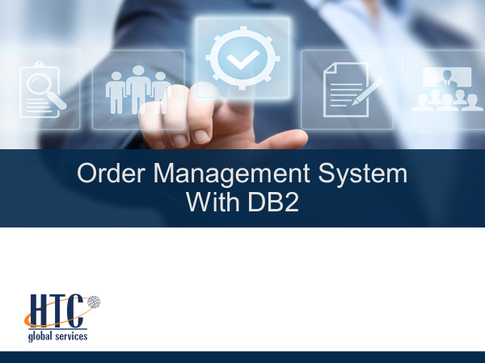

Slide 2
Introduction:
→The main concept of oms is checking product availability in the table with respect to quantity required in the Transaction-file and generating shipping-file and pending-file.
→Input files
Master table(PID,PNAME,QOH,PRICE).
Transaction-file as TIFILE.
→Output files
Shipping-file as SOUTFILE
Pending-file as POUTFILE

Slide 3
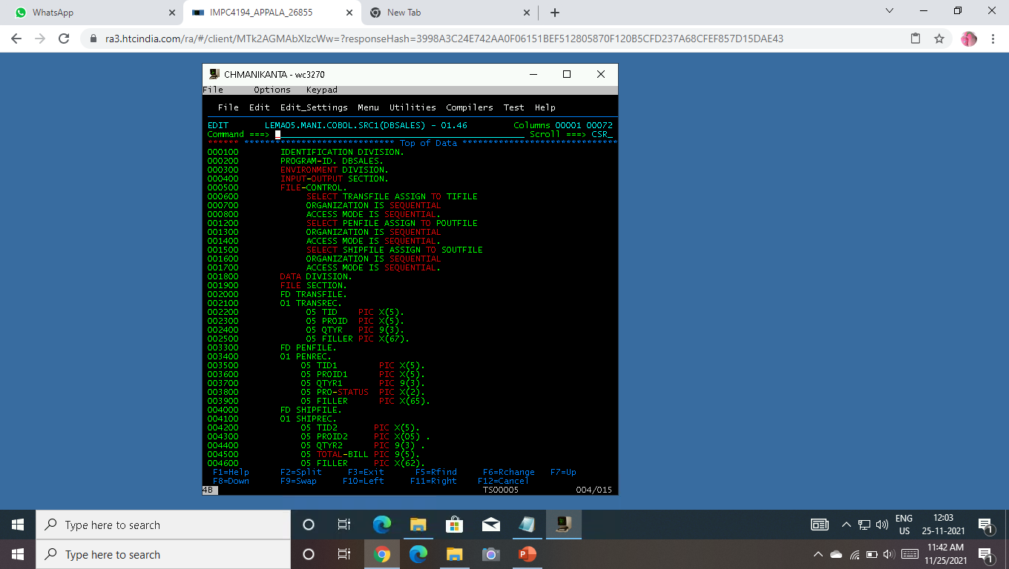
Source code:

Slide 4
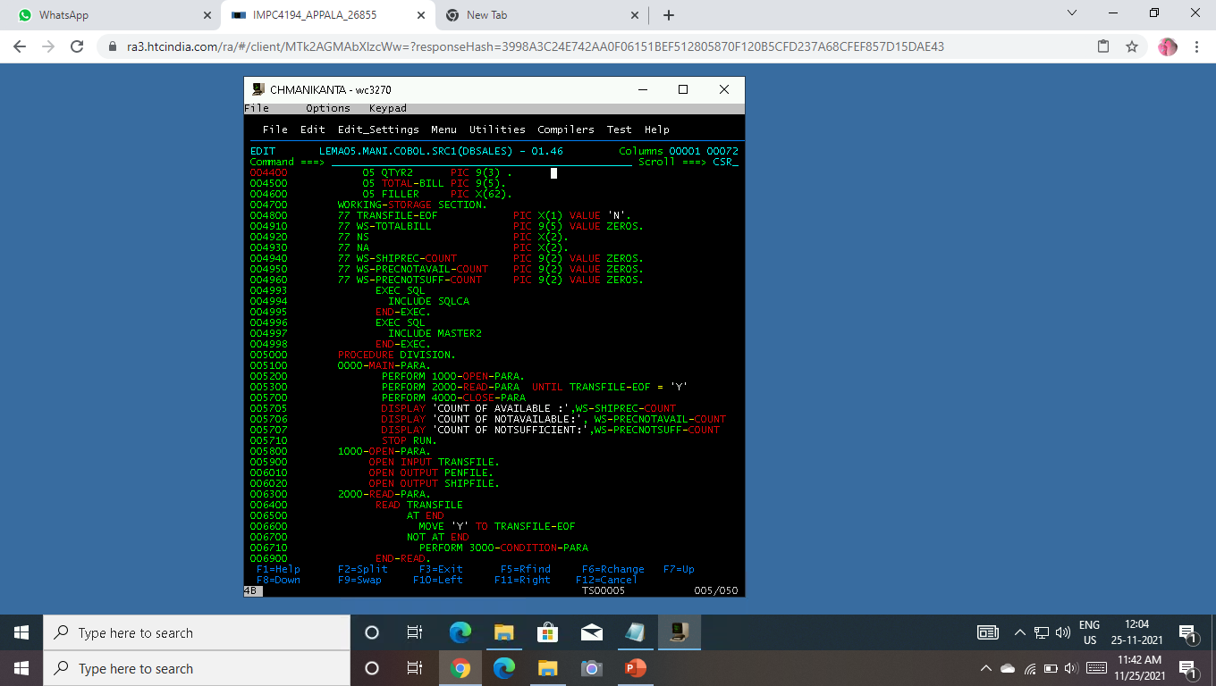

Slide 5
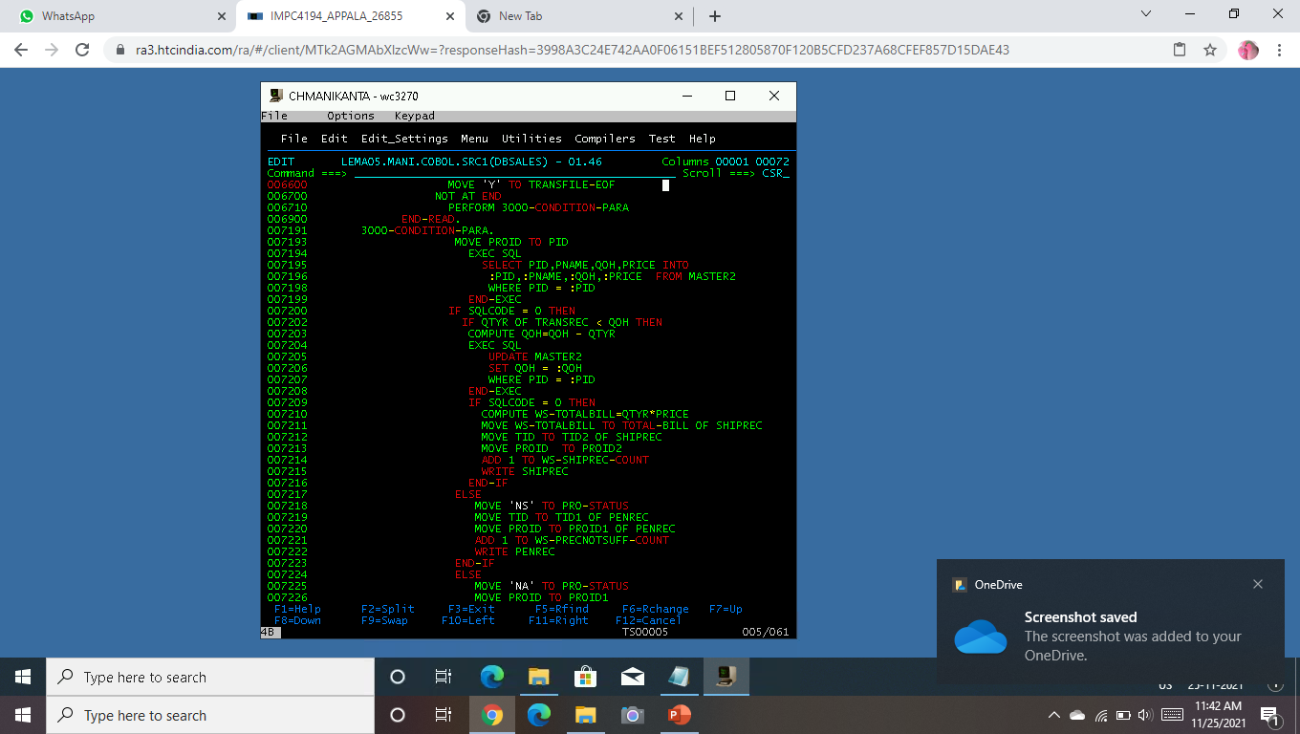

Slide 6
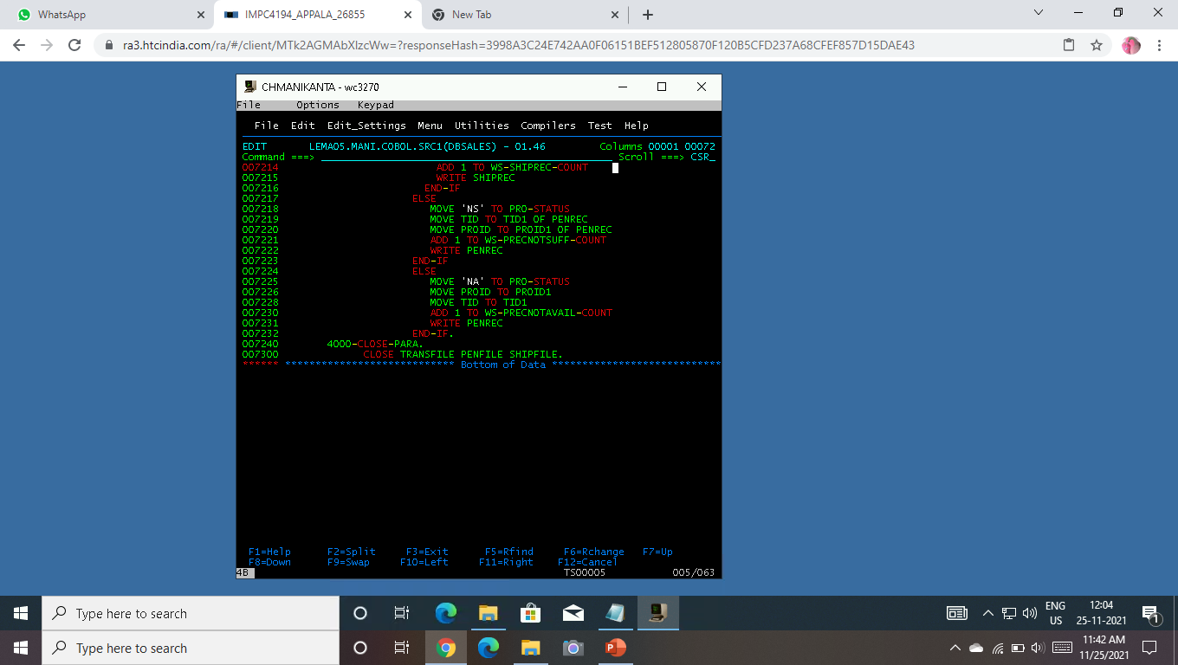

Slide 7
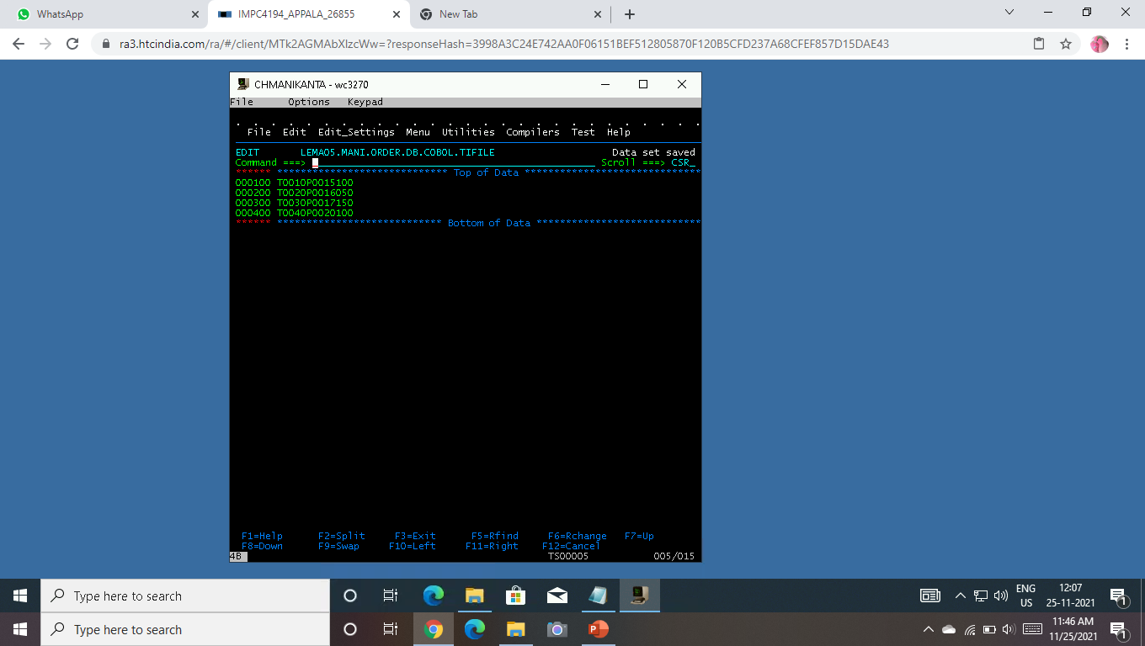
Input file as TIFILE

Slide 8
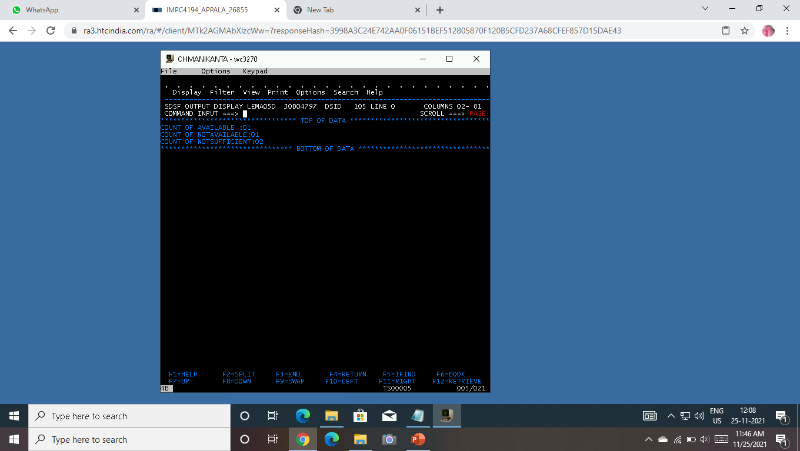
Output :

Slide 9
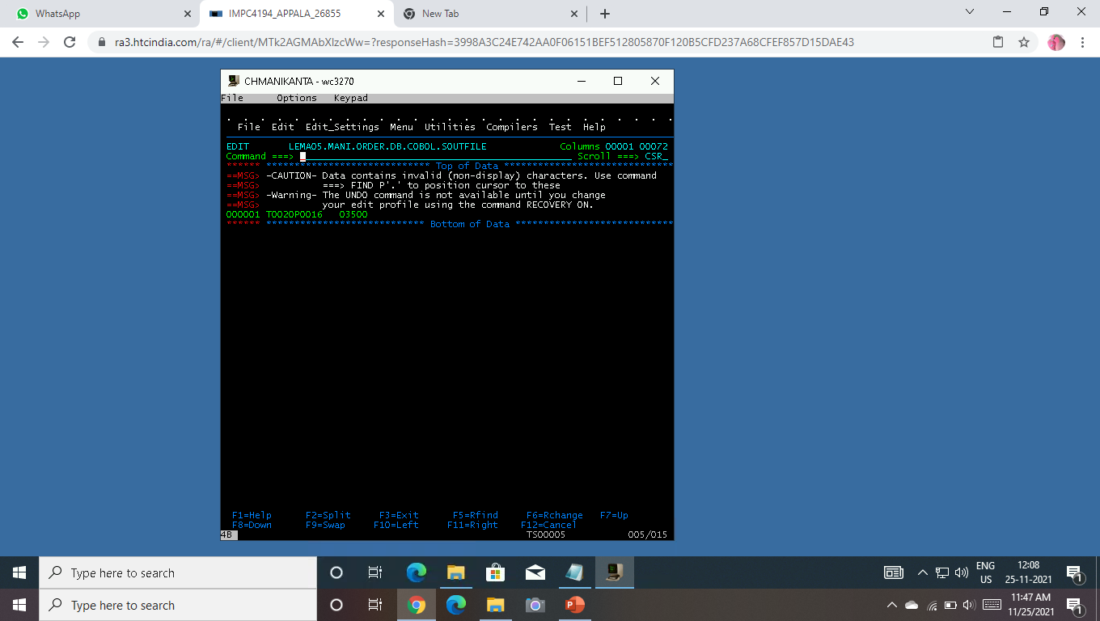
Shipping-file as SOUTFILE:

Slide 10
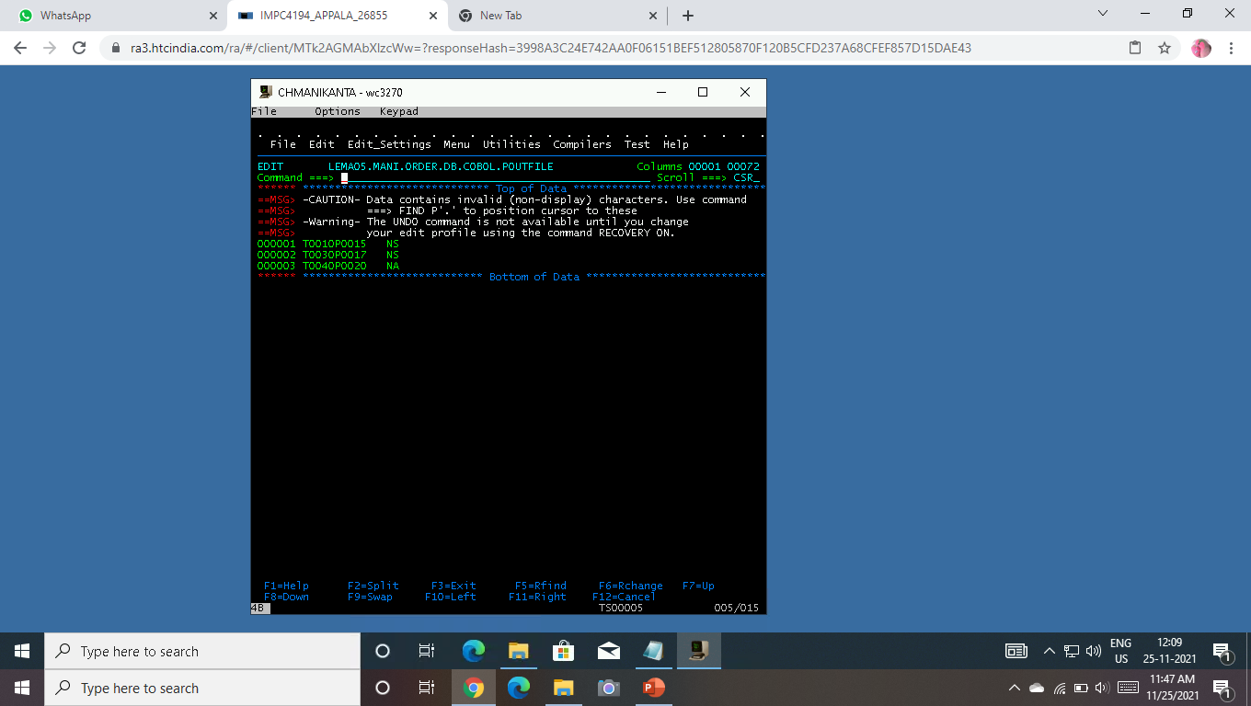
Pending-file as POUTFILE:

Slide 11


